Slide 1
Course Introduction 2019
Advanced Computer networks
赵振刚 gavin@ustc.edu.cn
Notes:
确切说，是Advanced Network Technology

Slide 2
Course Introduction 2019
Contents
Materials
Courses
About us

Slide 3
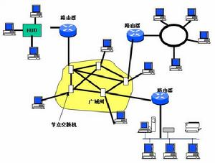
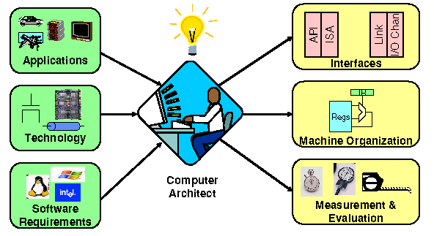
1. Contents
Computers and networks
Notes:
顾名思义的理解就是 计算机组成的网络，那么对计算机 对网络， 又该怎样去理解？

Slide 4
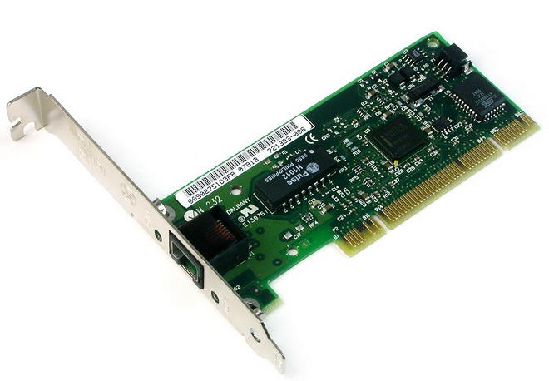
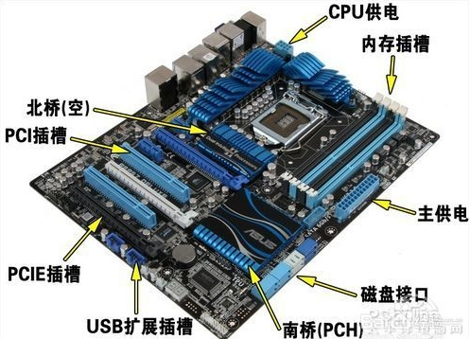
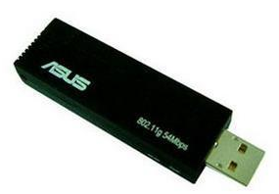
1.1 Computers’ hardware approach
Adapter

Slide 5
1.1 Computers’ hardware approach
Adapter
IP 地址
硬件地址
计算机
CPU 和
存储器
适配器
（网卡）
至外部网
并行
通信
串行通信
生成发送的数据
处理收到的数据
把数据发送到外部网
从外部网接收数据

Slide 6
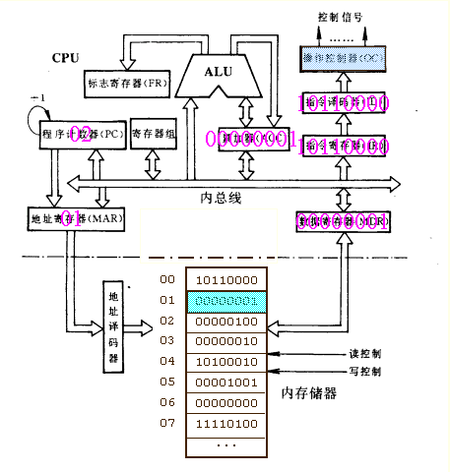
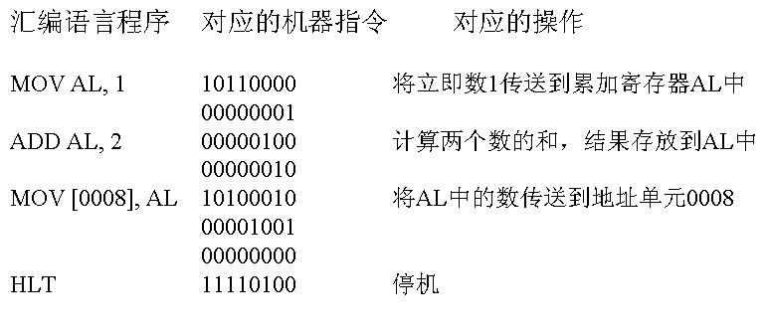
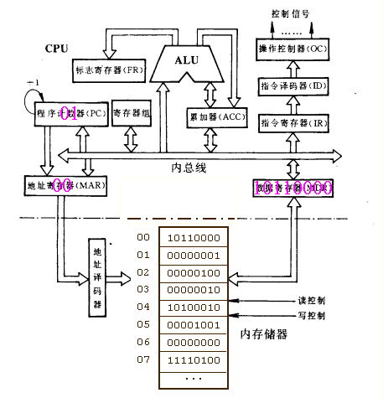
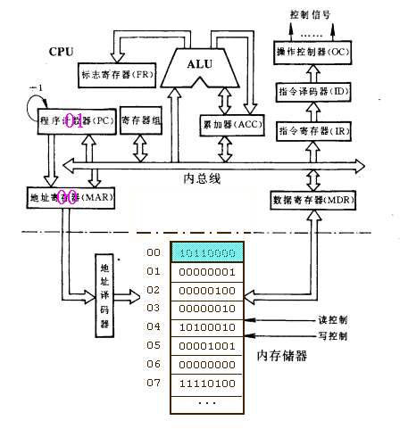
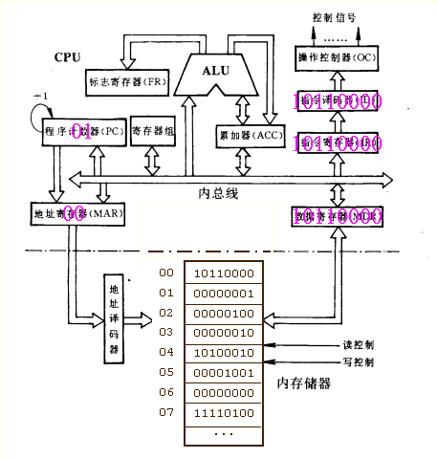
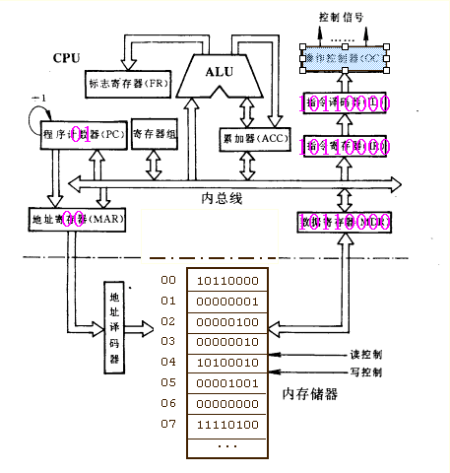
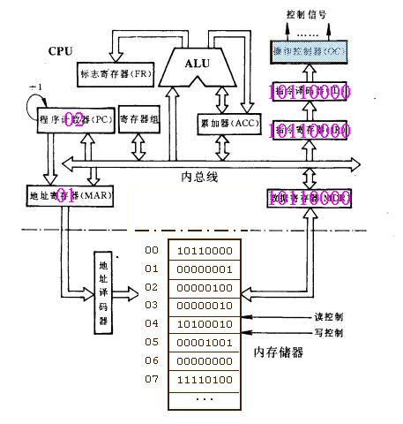
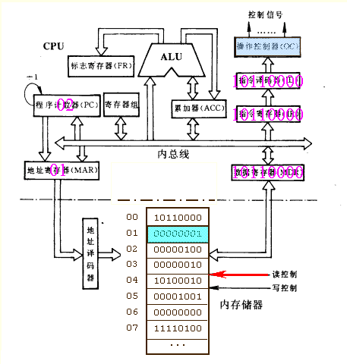
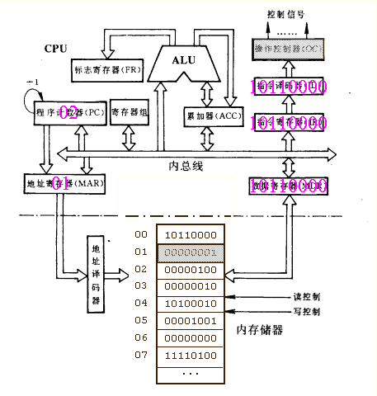
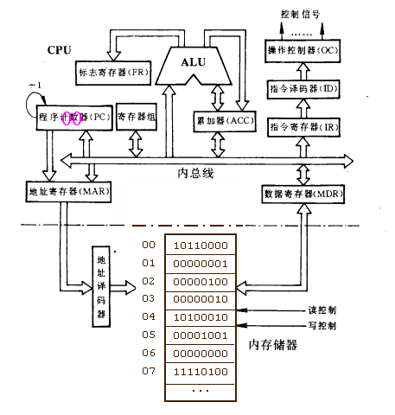
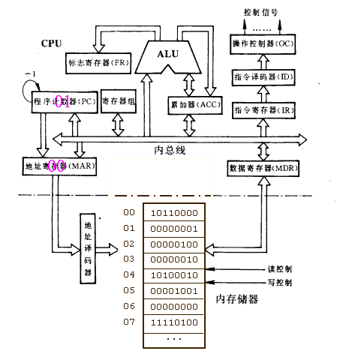
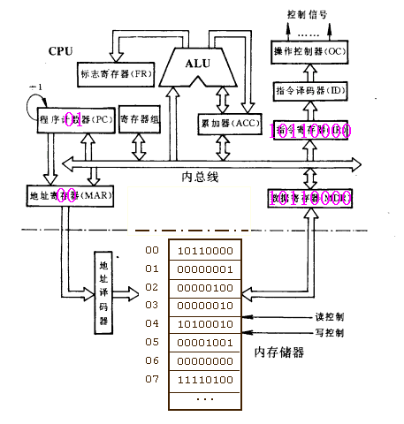

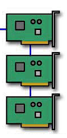
1.2 Computers’ hardware approach
对外部数据的计算和处理
外部设备
Notes:
6
有错，注意！

Slide 7

1.2 Computers’ software approach
DatagramSocket serverSocket = new DatagramSocket
(6428);
DatagramSocket mySocket2 = new DatagramSocket
(9157);
DatagramSocket mySocket1 = new DatagramSocket (5775);
application
application
P1
application
P3
P4
transport
transport
network
transport
network
link
network
link
physical
link
physical
physical
source port: 6428
dest port: 9157
source port: ?
dest port: ?
source port: 9157
dest port: 6428
source port: ?
dest port: ?
Notes:
Process，introduced in Multics system
Linux daemon process
Windows servers, Nettcp…

Slide 8
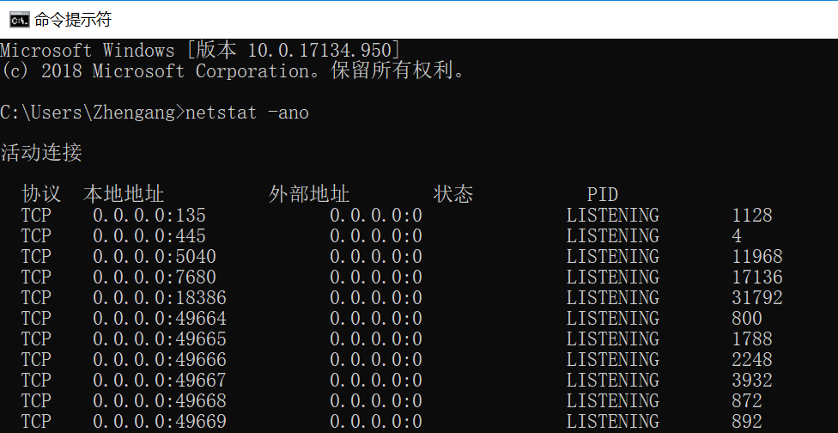
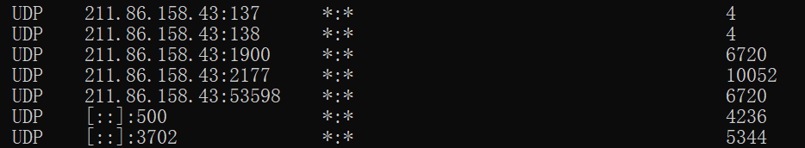
1.2 Computers’ software approach
Notes:
动手练一练

Slide 9
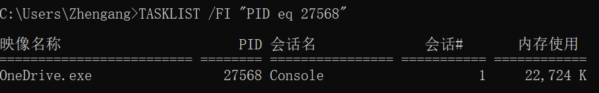
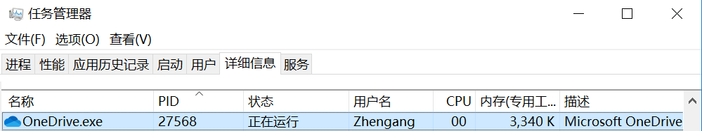

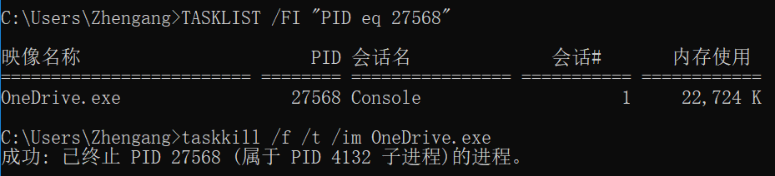

1.2 Computers’ software approach
Notes:
动手练一练

Slide 10
1.3 Computers’ communication approach
数据与分层模型
计算机 1
计算机 2
AP₁
应用层首部
应 用 程 序 数 据
AP₂
5
运输层首部
5
H₅
应 用 程 序 数 据
网络层首部
4
H₄
H₅
应 用 程 序 数 据
4
链路层
首部
链路层
尾部
3
H₃
H₄
H₅
应 用 程 序 数 据
3
2
H₂
H₃
H₄
H₅
应 用 程 序 数 据
T₂
2
1
10100110100101 比 特 流 110101110101
1
Notes:
Header+Payload

Slide 11
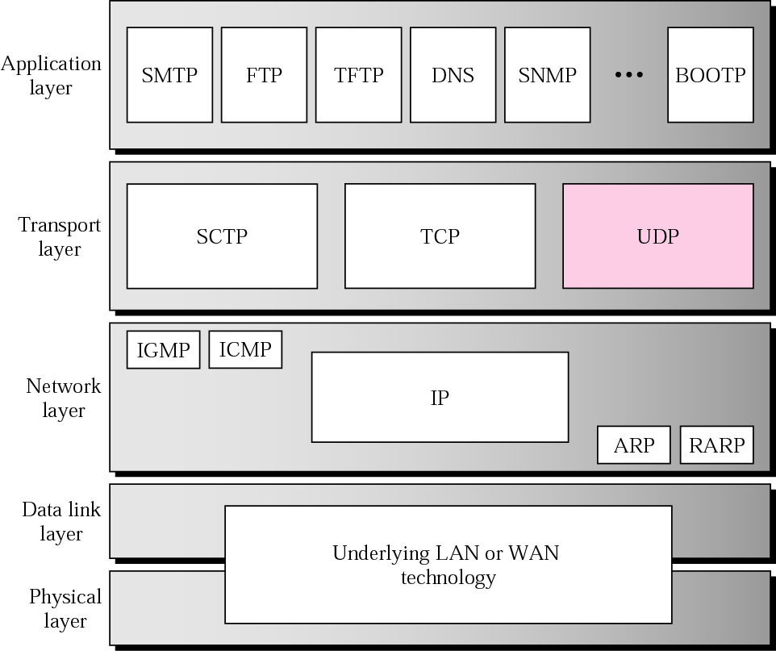
1.3 Computers’ communication approach
Protocol layers

Slide 12
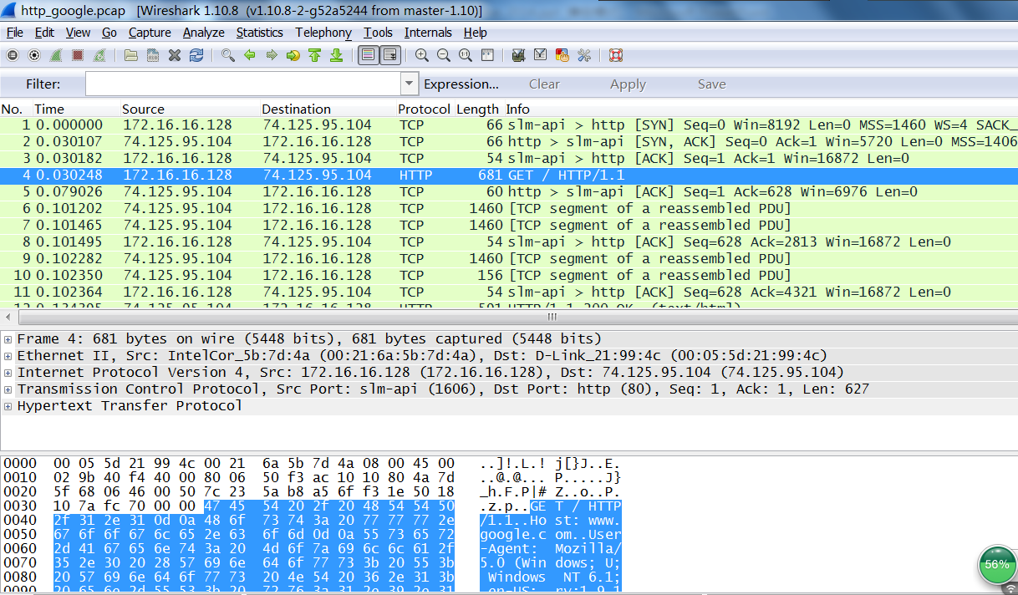
1.3 Computers’ communication approach

Slide 13
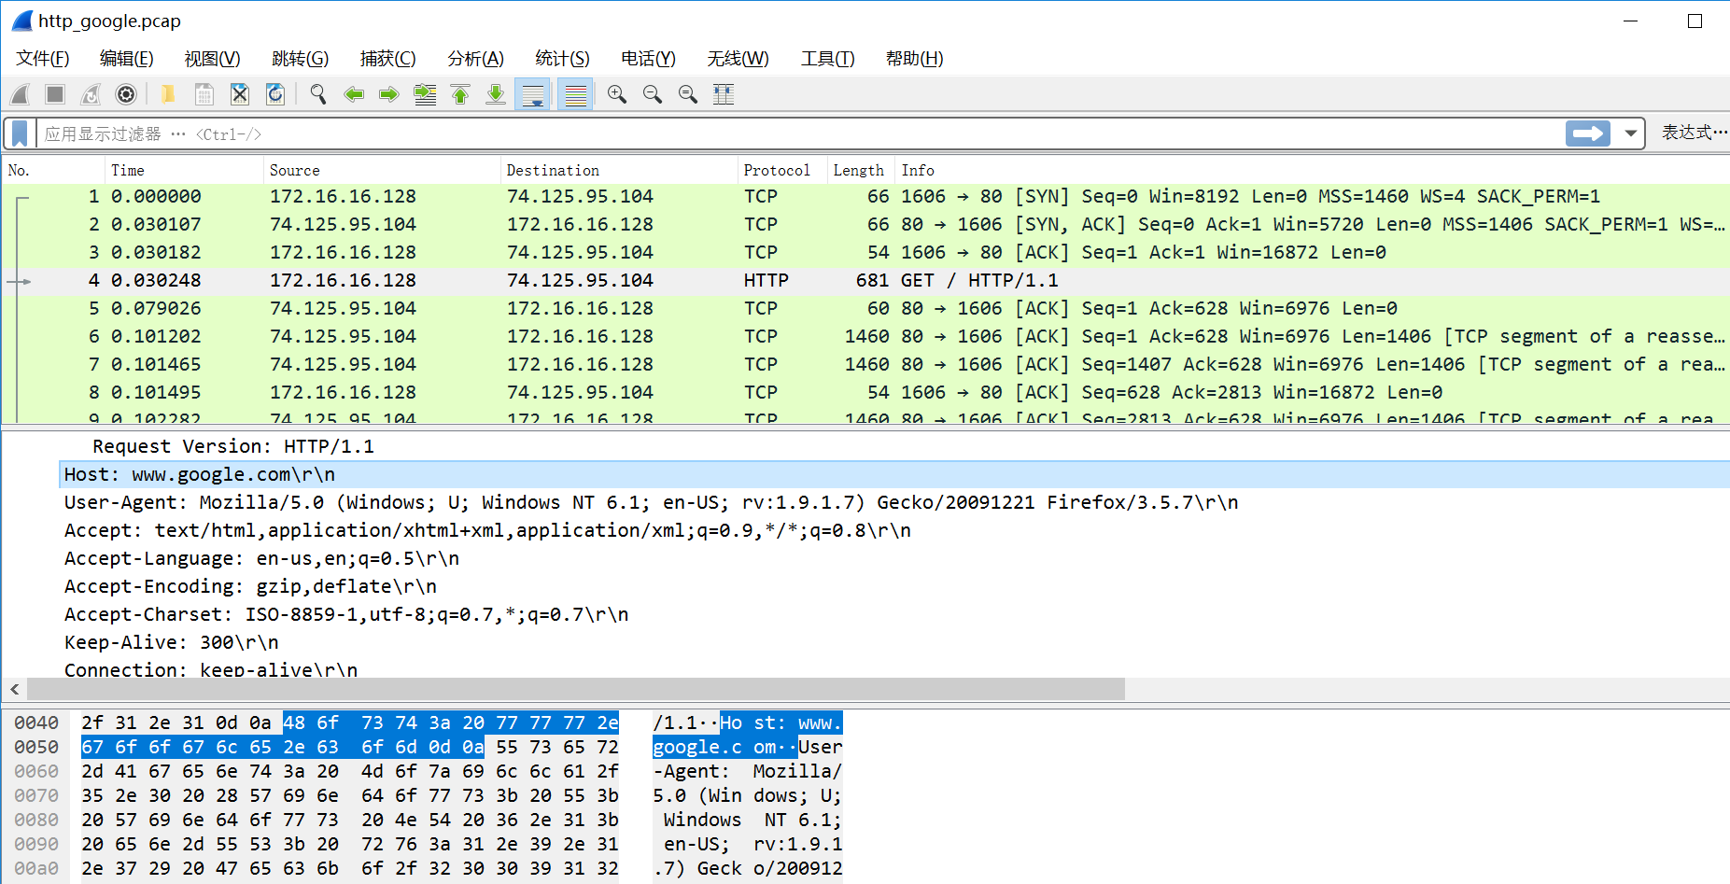
1.3 Computers’ communication approach

Slide 14
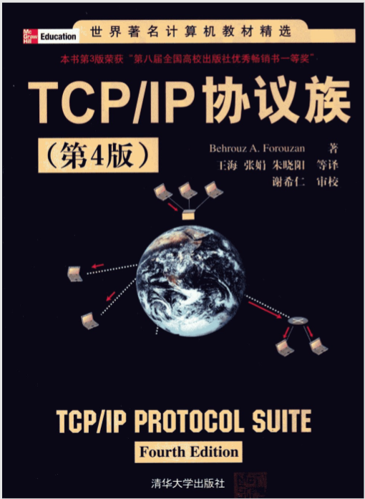
2. Materials
textbook

Slide 15
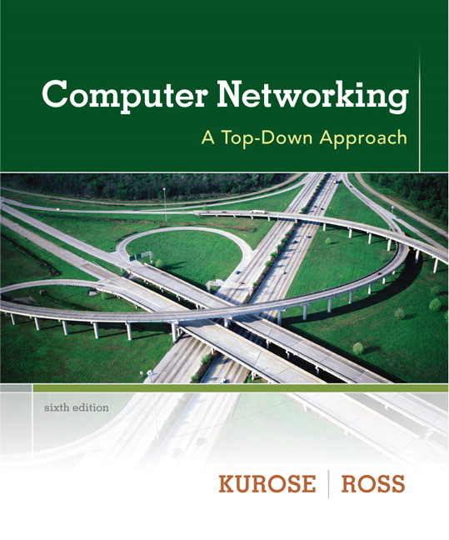
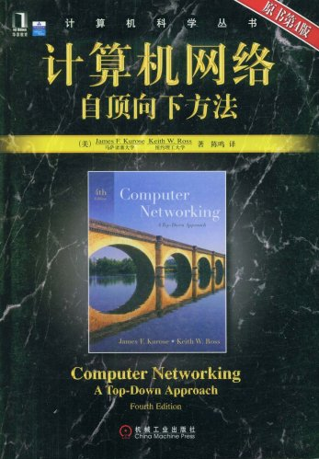
2. Materials
Readings

Slide 16
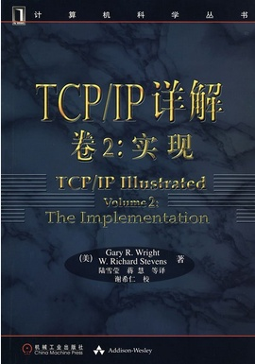
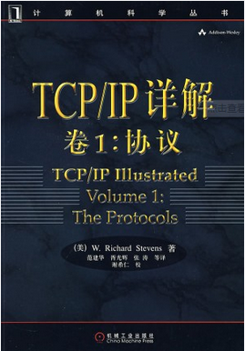
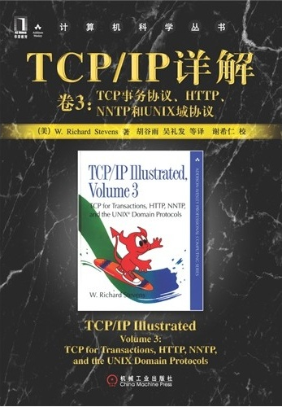
2. Materials
Readings
Notes:
W. Richard Stevens(1951-1999)

Slide 17
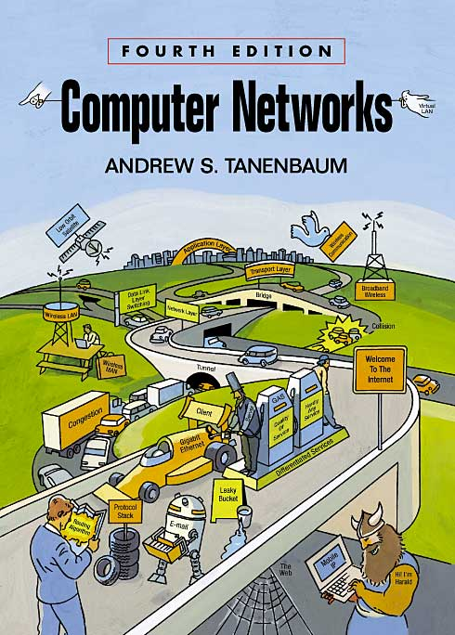
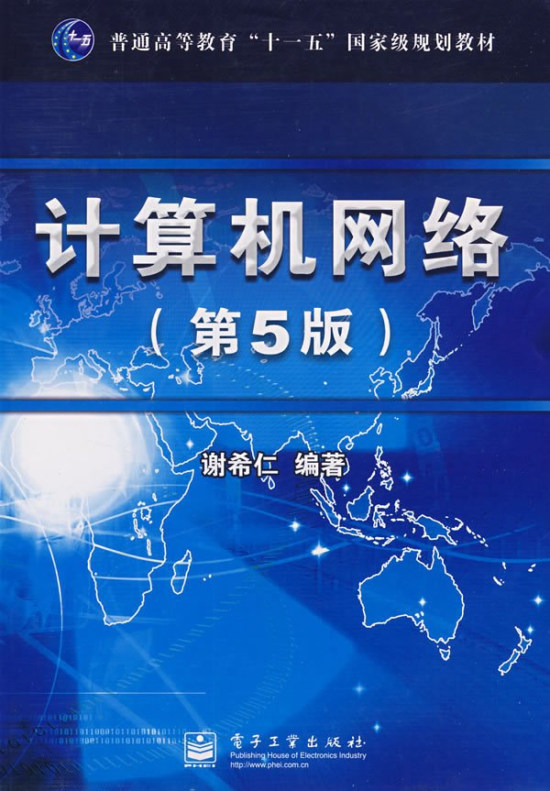
2. Materials
Readings
Notes:
谢希仁版:
概念准确、论述严谨、内容新颖、图文并茂，突出基本原理和基本概念的阐述
Tanenbaum，荷兰阿姆斯特丹 Vrije 大学计算机教授，早年毕业于麻省理工学院：
该教材重在叙述，强调背景和过程，适合扩展阅读和深入理解
http://authors.phptr.com/tanenbaumcn4
http://www.cs.vu.nl/~ast/

Slide 18
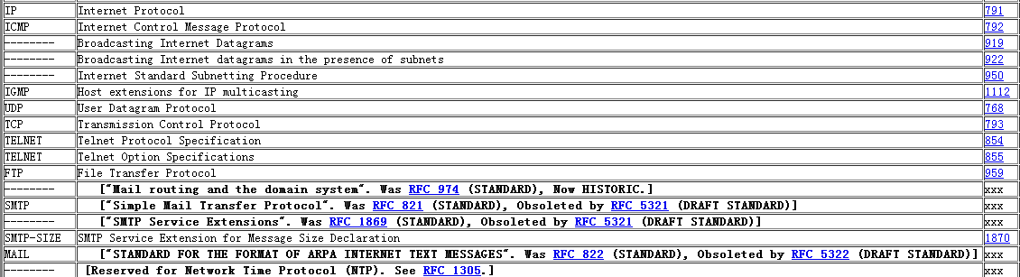
2. Materials
Request For Comments
http://www.ietf.org/rfc.html

Slide 19
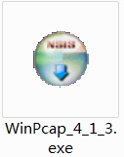
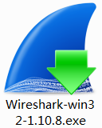
2. Materials
Protocol analysis tools
http://www.wireshark.org/
Notes:
WinPcap是用于网络封包抓取的一套工具，可适用于32/64位的操作平台上解析网络封包，包含了核心的封包过滤，一个底层动态链接库，和一个高层系统函数库，及可用来直接存取封包的应用程序界面

Slide 20
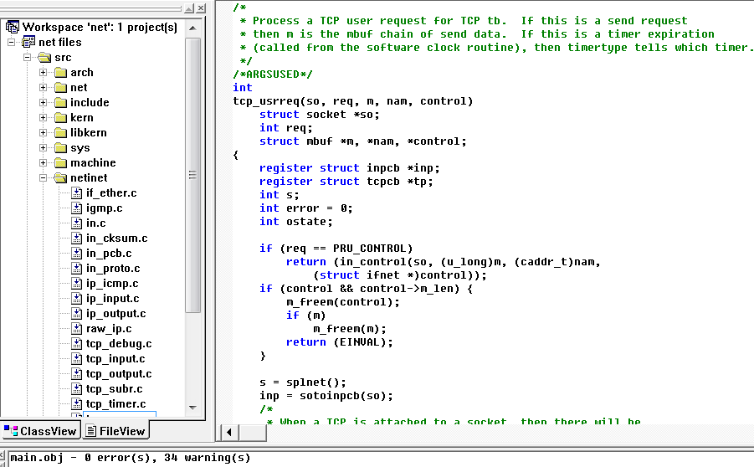
2. Materials
Codes analysis 4.4BSD
Notes:
WinPcap是用于网络封包抓取的一套工具，可适用于32/64位的操作平台上解析网络封包，包含了核心的封包过滤，一个底层动态链接库，和一个高层系统函数库，及可用来直接存取封包的应用程序界面

Slide 21
2. Advanced Materials
It is not the end of the world, it is the end of the beginning
Many new fronts for technology innovation!!!

Slide 22
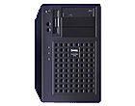
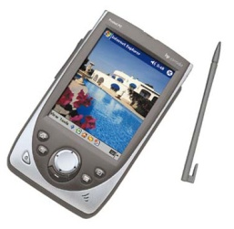
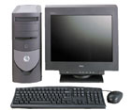
Indirection via “Proxy”
2. Advanced Materials
Proxy bridges the server and the client
Move complexity away from both server and client
Generalized end-to-end argument: “edge” rather than “end” systems
Little changes at server & client
server
proxy
client

Slide 23
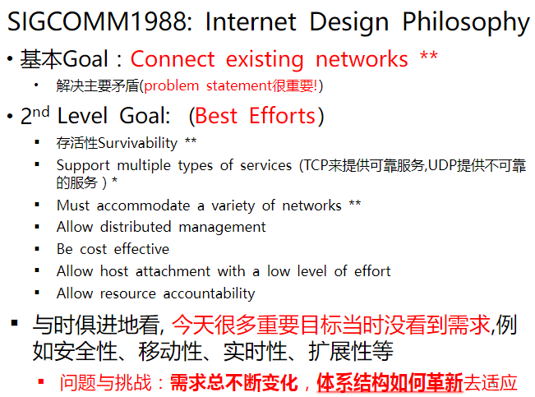
2. Advanced Materials
摘自清华大学毕军 北邮讲座

Slide 24
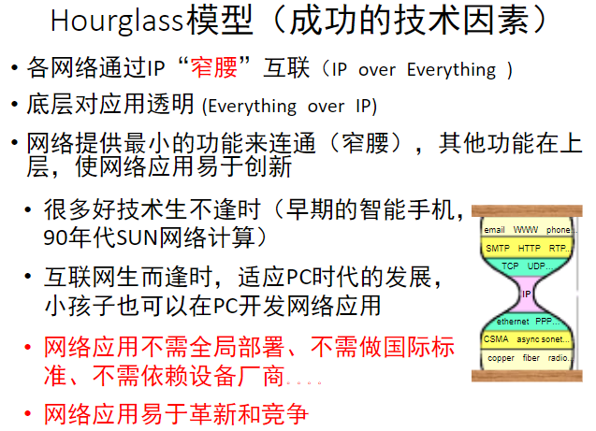
2. Advanced Materials
摘自清华大学毕军 北邮讲座

Slide 25
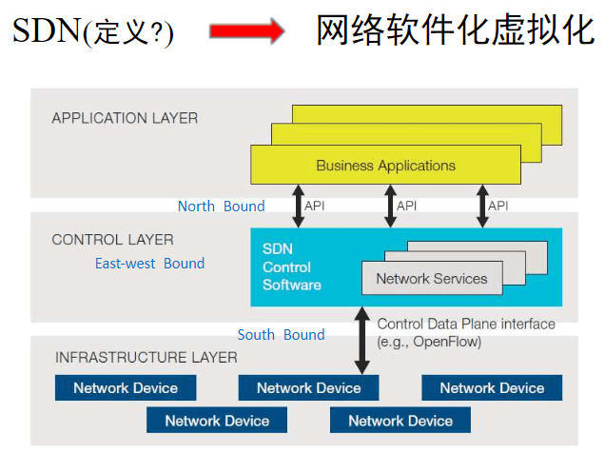
2. Advanced Materials
摘自清华大学毕军 北邮讲座

Slide 26
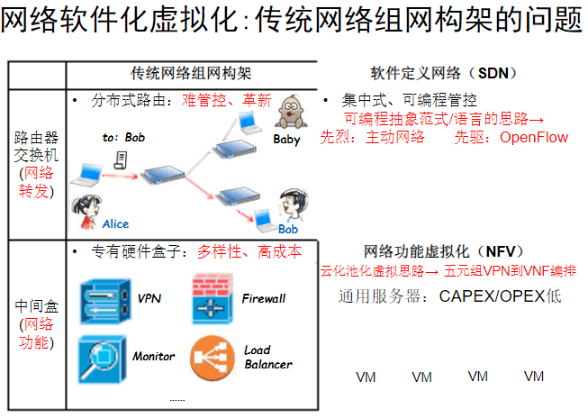
2. Advanced Materials
摘自清华大学毕军 北邮讲座

Slide 27
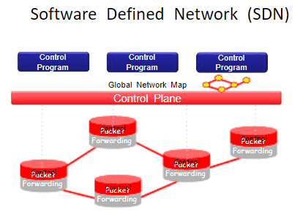
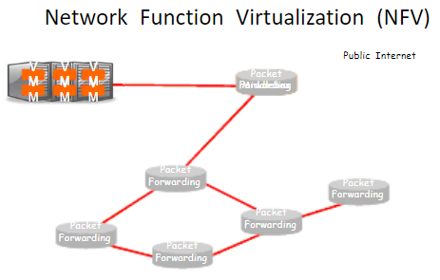
2. Advanced Materials
摘自清华大学毕军 北邮讲座

Slide 28
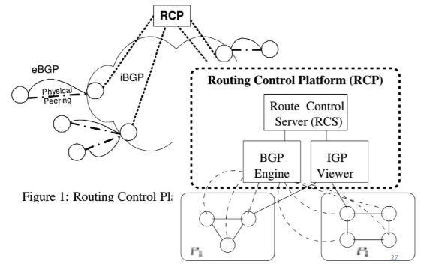
2. Advanced Materials
摘自清华大学毕军 北邮讲座

Slide 29
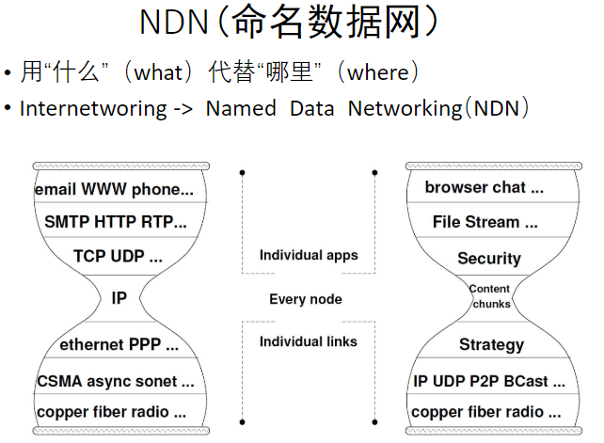
2. Advanced Materials
摘自清华大学毕军 北邮讲座

Slide 30
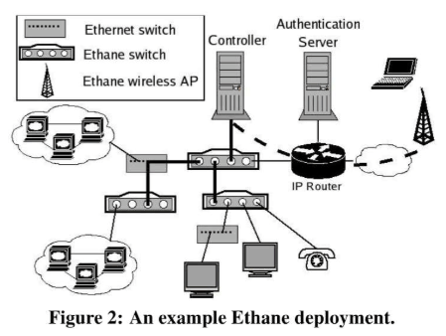
2. Advanced Materials
摘自清华大学毕军 北邮讲座

Slide 31


2. Advanced Materials
摘自清华大学毕军 北邮讲座
Notes:
数据平面和控制平面分离后，左图是数据平面缓存流的控制规则，右图是协议格式

Slide 32
2. Advanced Materials
摘自清华大学毕军 北邮讲座
Notes:
又比如 移动互联网的发展

Slide 33
Drivers for Wireless Research
New Applications,
Services, Requirements
Top
Up
Transport Layer
Network Layer
Down
Link Layer
Bottom
New Wireless
Communications Technology

Slide 34
Top Down Driver: User Demand
Many of them:
New applications
MMS, P2P image/video sharing, IP TV streaming, …
New requirements
Security, privacy, robustness/dependability, distributed management
New services
Location-based service, Personalized service, …
New trends
Interoperability of different wireless technologies
Challenge: How to support such new demands?

Slide 35

Top Down Driver: User Demand
思贤楼实验实例

Slide 36
2. Advanced Materials
Telcom approach: “Smart CORE, Dumb Terminal”
The core ensures correctness (e.g., reliability)
TCP/IP approach: “Smart Terminal, Dumb CORE”
摘自清华大学毕军 北邮讲座
Notes:
数据平面和控制平面分离

Slide 37
2. Advanced Materials
……
摘自清华大学毕军 北邮讲座
Notes:
数据平面和控制平面分离

Slide 38






2. Advanced Materials
Videos

Slide 39
3. Courses
An engineers technological lecture
Notes:
由前人的经验和实践演化而来，更多的是种约定俗成，并不断吸收新的理论

Slide 40
Ours’ target
Master basic concepts such as C/S and P2P model，Socket, Ethernet, and technologies that woven together in an intricate manner.
Be familiar with TCP/IP protocols， architecture of internet，skilled at Socket programming

Slide 41
3. Courses
Theory teaching：50 hours，8 times
Experiment courses：20 hours，5 times
score ：
test (closed book)： 60%
experiment and homework: 40%

Slide 42
experiment courses
Exp1. Packet sniffer and analysis based on Wireshark
Exp2. Development of e-mail protocol(SMTP/POP3)
Exp3. Socket programming
Exp4. Routing based on RouteSim
Exp5. ……

Slide 43
4. Teachers or advisers
赵振刚 http://staff.ustc.edu.cn/~gavin/
gavin@ustc.edu.cn
思贤楼507(西区学生食堂电梯5楼右手边)
0512-68839303

Slide 44
5.conference and workshops
ACM Sigcomm, MobiCom, Hotnets
Mobihoc sigmetrics
Infocom Sensys IPSN ICNP
a）trans
IEEE/ACM Trans.networking IEEE JSAC
IEEE Tran.mobile computing
IEEE Trans on Parallel and Distributed Systems
IEEE TWC IEEE TVT
b) magazine
ACM Computing surveys
Communications of the ACM
IEEE communication magazine IEEE network
IEEE wireless communications
SCI
Notes:
Hotnets: Workshop on Hot Topics in Networks

Slide 45
Thanks

